Slide 1
Secure Data Hiding in Image Using Steganography
CAPSTONE PROJECT
Presented By: Rakesh Kumar Parida
Student Name : Rakesh Kumar Parida
College Name & Department : ABIT, Cuttack – B.Tech CSE

Slide 2
OUTLINE
Problem Statement
Technology used
Wow factor
End users
Result
Conclusion
Git-hub Link
Future scope

Slide 3
Problem Statement
In today's digital world, securing sensitive information is crucial. Traditional encryption methods can attract attention, making them vulnerable.
Steganography offers a covert way to hide data within images, ensuring secrecy without raising suspicion. Our project implements Image Steganography using the Least Significant Bit (LSB) technique to embed and extract hidden messages securely.

Slide 4
Technology used
Programming Language: Java
Libraries: Java AWT, Swing, javax.imageio, BufferedImage
Tools & Platforms: NetBeans IDE, JDK
File Handling: PNG, BMP formats, FileInputStream, FileOutputStream

Slide 5
Wow factors
Fast and Efficient – Converts images quickly without heavy processing.
Simple and Lightweight – No unnecessary features, just straightforward image conversion.
Cross-Platform Compatibility – Works on any system with Java installed.
Minimal Dependencies – Uses Java's built-in libraries, reducing setup hassle.
User-Friendly GUI – Easy-to-use interface built with Swing for a smooth experience.

Slide 6
End users
Journalists & Whistleblowers: To transmit confidential information securely.
Military & Government Agencies: For secure communication.
Businesses: To protect sensitive corporate data.

Slide 7
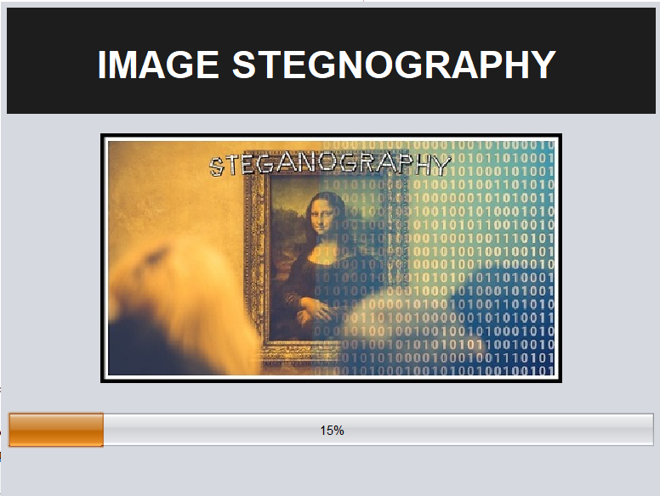
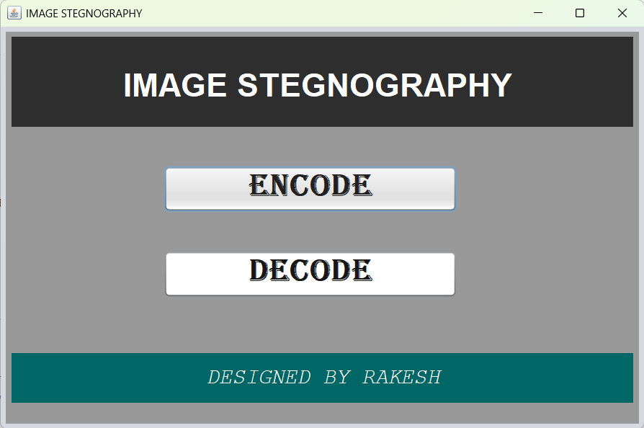
Results
Splash Screen
Menu Screen

Slide 8
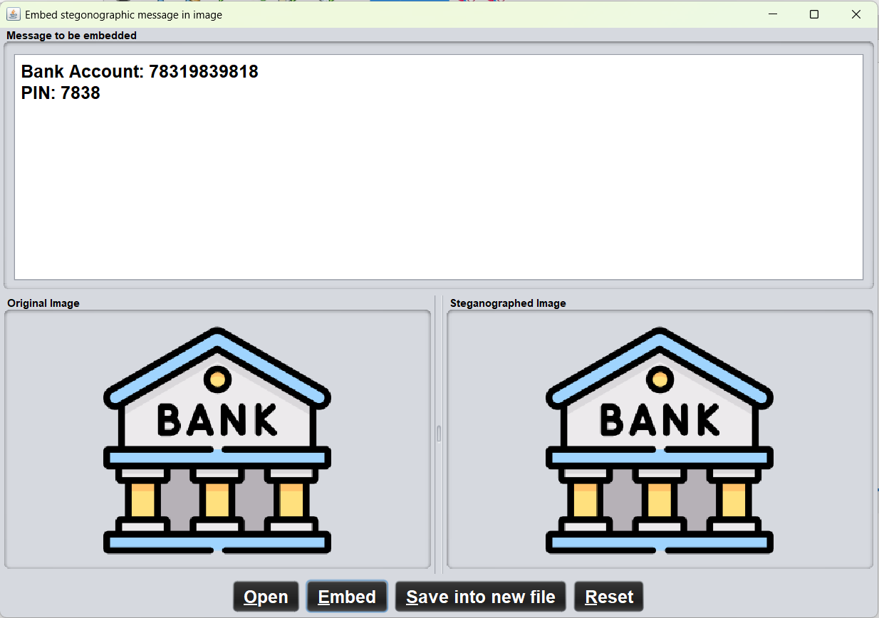
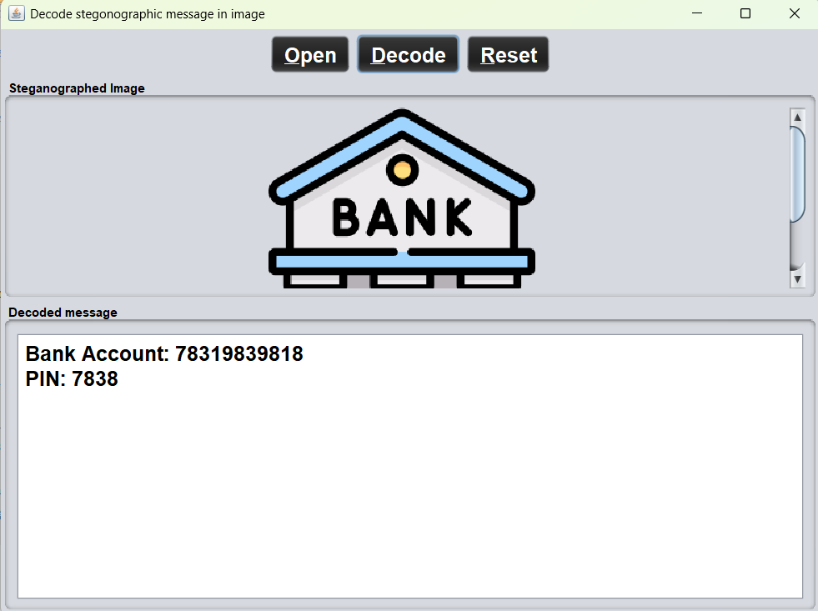
Results
Encryption Screen
Decryption Screen

Slide 9
Conclusion
This project demonstrates the power of steganography in securely hiding and retrieving sensitive information within images.
By leveraging the Least Significant Bit (LSB) technique, we achieve an efficient and undetectable method for data concealment.
The system ensures data security and confidentiality, making it useful for cybersecurity applications, secure communication, and digital watermarking.

Slide 10
GitHub Link
https://github.com/Rakesh0045/Edunet-CyberSecurity-Project

Slide 11
Future scope(optional)
Enhanced Security – Implement encryption techniques like AES to make hidden data more secure.
Multi-Format Support – Extend support to other image formats like BMP for wider usability.
Steganalysis Resistance – Improve techniques to prevent detection by steganalysis tools.
Increased Data Capacity – Optimize the LSB algorithm to store larger messages without quality loss.
Real-World Applications – Adapt for secure government or corporate data exchange.

Slide 12
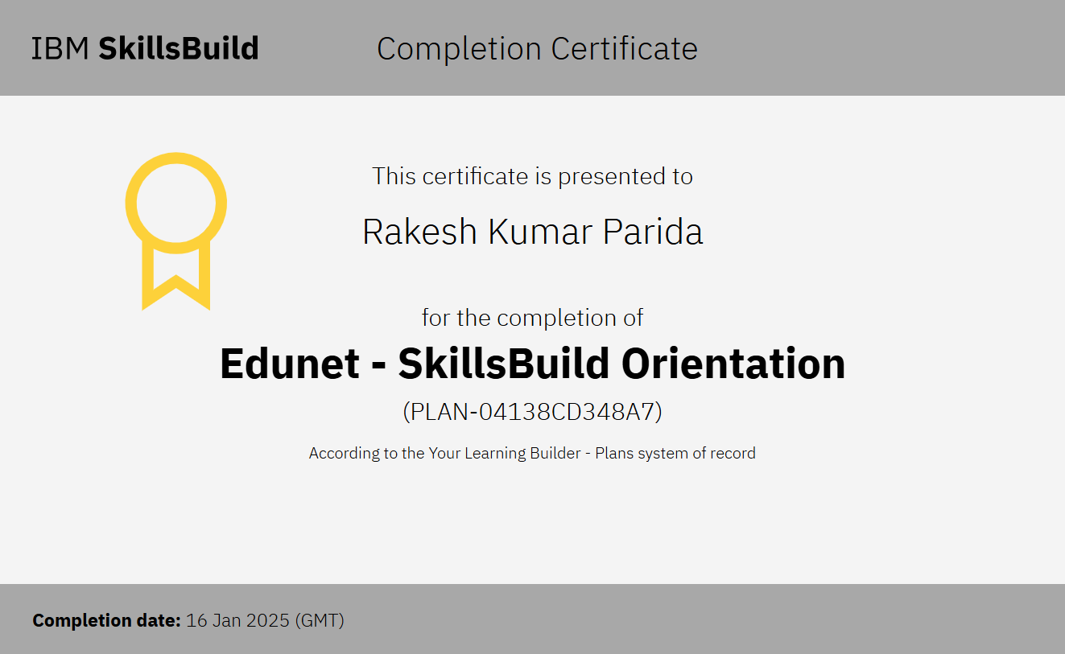
ORIENTATION CERTIFICATE

Slide 13
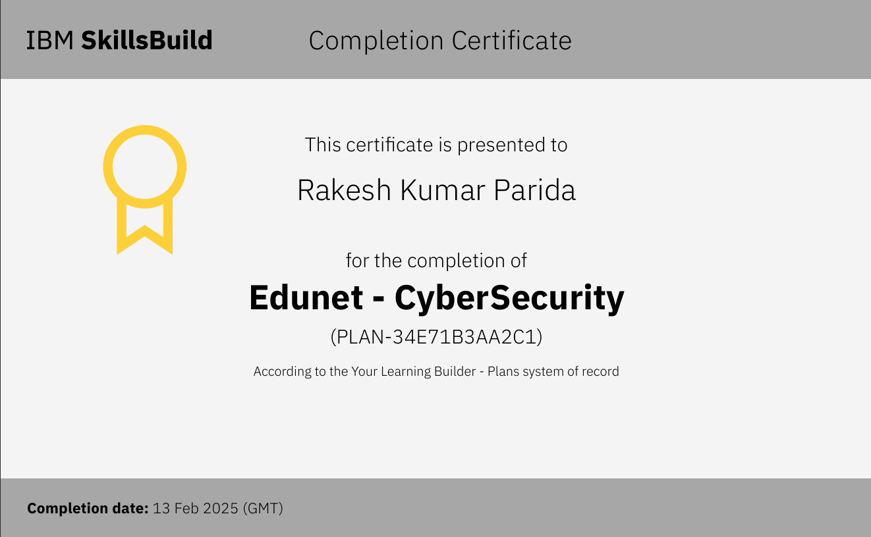
COURSE CERTIFICATE

Slide 14
THANK YOU

